Slide 1
Haifa::c++
Compiler-friendly C++ for developer-friendly compilations
Majd Haj
June 26th 2023

Slide 2
A bit about me
BSc. In computer science from the Technion, 2016-2020.
Started working in Cadence in 2018 as an intern.
Full time SW engineer since 2020.
I’ve been in the JasperGold project in Cadence since day 1.
JasperGold includes a bundle of hardware formal verification apps, which are used by physical designers and verification engineers at other hardware design companies.
C++ has been my main programming language since I joined Cadence.
https://xkcd.com/303/

Slide 3
The problem

Slide 4

The problem
The compilation process can take a lot of time.
In this session, we will try to tackle this problem by understanding some aspects of the compilation process, going over some techniques that can help make the compilation process faster, and present some tools that can help.
https://xkcd.com/303/

Slide 5
Agenda
C++ Compilation In A Nutshell
A short summary of how the compiler works
Header guards, templates and inline definition in headers
Physical Design 101
Logical vs. physical design
Physical dependency graphs
Levelization and Levelization Techniques
Total and Partial Insulation
Miscellaneous ways to speed up compilation
Excessive includes, iwyu, Clang
Dev acceleration platforms
https://xkcd.com/303/

Slide 6
C++ Compilation In A Nutshell

Slide 7
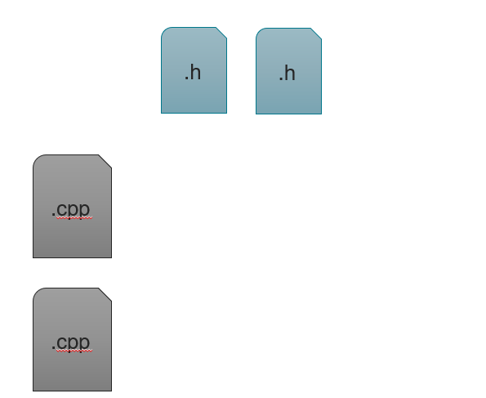
C++ Compilation In A Nutshell
Disclaimer: the compilation process is very complicated, and this is an overly simplified version of it.
A project consists of header files (.h) and cpp files (.cpp):

Slide 8
C++ Compilation In A Nutshell - building phase 1
The first step is passing the .cpp files through the preprocessor.
The preprocessor will copy each one of the included header files (recursively) into the cpp file, amongst other things like macro replacements, and create matching .ii files.
.h
.h
.cpp
Preprocessor
.ii
.cpp
Preprocessor
.ii

Slide 9
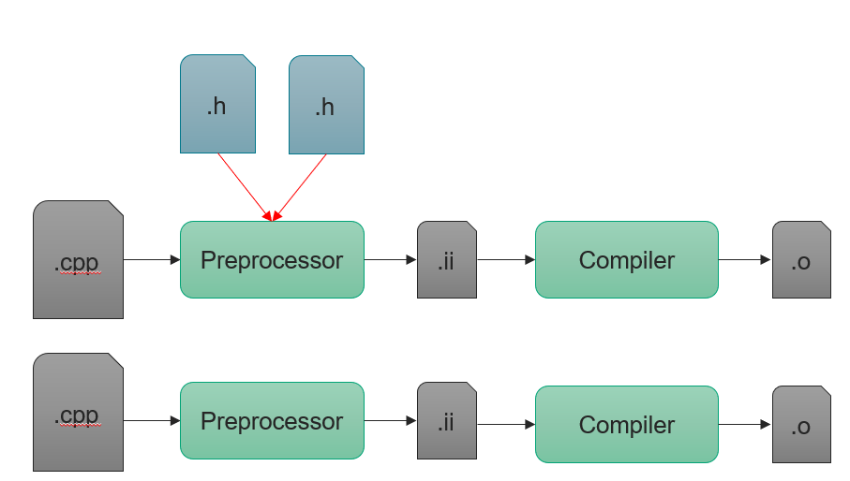
C++ Compilation In A Nutshell - building phase 2
Then the .ii files will be fed to the compiler, and it will produce object files (.o)

Slide 10
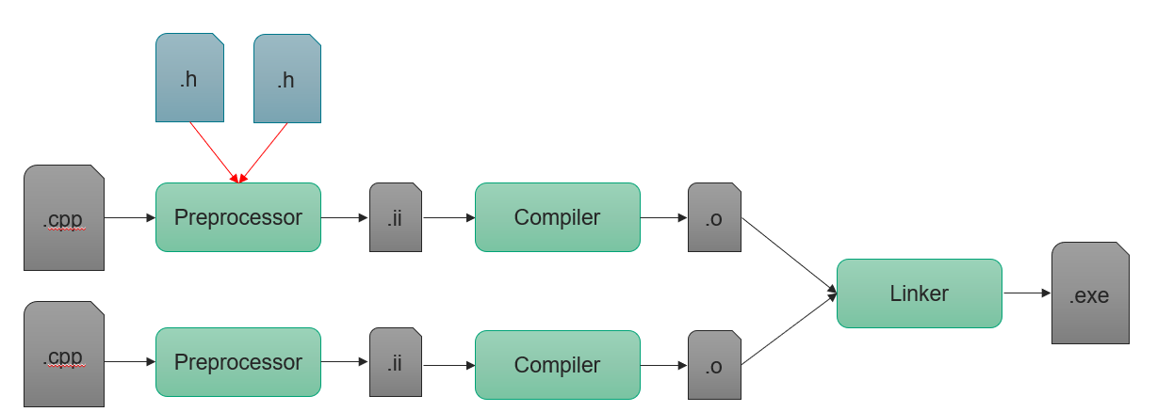
C++ Compilation In A Nutshell - building phase 3
The last phase is linking all the object files together and creating an executable.

Slide 11
C++ Compilation In A Nutshell - building phase 3
This phase might vastly differ depending whether we’re creating a program / application or a library (it can be both static and dynamic). However, for our purposes, this simplification is good enough.

Slide 12
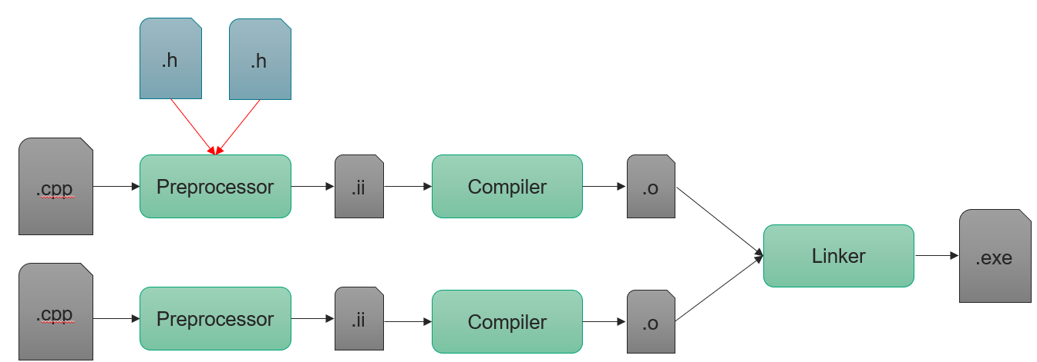
C++ Compilation In A Nutshell - building phase 3
Important note: each cpp file is compiled separately and independently from other cpp files, it’s only at the linking stage that the whole program is handled as a whole unit.

Slide 13
C++ Compilation In A Nutshell - Declaration vs. definition
Declarations introduce (or re-introduce) names into the C++ program:
Declarations inform the compiler that there is an entity somewhere with a specified name. Each kind of entity is declared differently. In our example, a function is declared using its signature (return type, name, and arguments), and a class is declared with its name.
Each entity can be declared multiple times.
int add(int, int);
class Calculator;

Slide 14
C++ Compilation In A Nutshell - Declaration vs. definition
Definitions are declarations that fully define the entity introduced by the declaration:
Only one definition of any entity is allowed in any one compilation unit (some of these may have multiple declarations, but only one definition is allowed).
int add(int a, int b)
{
return a + b;
}
class myClass {
int m_value;
};

Slide 15
C++ Compilation In A Nutshell - Header guards
The problem:
//engine.h
class Engine {
int m_horsepower;
};
//main.cpp
#include “engine.h”
#include “car.h”
int main()
{
Car c;
Engine e;
std::cout <<“vroom vroom”;
}
//car.h
#include “engine.h”
class Car {
Engine m_engine;
};

Slide 16
C++ Compilation In A Nutshell - Header guards
During the first compilation step, the main.cpp file is passed to the preprocessor, and it will copy all the included header files to the cpp file:
Engine class is defined twice
Compilation
Error!
//main.cpp
//from engine.h
class Engine {
int m_horsepower;
};
//from car.h
#include “engine.h”
class Car {
Engine m_engine;
};
int main()
…
//main.cpp
//from engine.h
class Engine {
int m_horsepower;
};
//from car.h
class Engine {
int m_horsepower;
};
class Car {
Engine m_engine;
};
int main()
…
//main.cpp
#include “engine.h”
#include “car.h”
int main()
…
Resolve the engine.h and car.h includes
Resolve the engine.h include again

Slide 17
C++ Compilation In A Nutshell - Header guards
Header guards to the rescue! (also called include guards)
//engine.h
#ifndef ENGINE
#define ENGINE
class Engine {
int m_horsepower;
};
#endif // ENGINE
//main.cpp
#include “engine.h”
#include “car.h”
int main()
{
Car c;
Engine e;
std::cout <<“vroom vroom”;
}
//car.h
#include “engine.h”
class Car {
Engine m_engine;
};

Slide 18
C++ Compilation In A Nutshell - Header guards
Using header guards can force the compiler to copy the content of engine.h only once.
//engine.h
#ifndef ENGINE
#define ENGINE
class Engine {
int m_horsepower;
};
#endif // ENGINE
//main.cpp
#include “engine.h”
#include “car.h”
int main()
{
Car c;
Engine e;
std::cout <<“vroom vroom”;
}
//car.h
#include “engine.h”
class Car {
Engine m_engine;
};

Slide 19
C++ Compilation In A Nutshell - Header guards
Now during the second step, the compiler will see that ENGINE is already defined, so the content between #define and #endif will not be copied again, and the compilation will succeed.
//main.cpp
//from Engine.h
class Engine {
int m_horsepower;
};
//from Car.h
#include “Engine.h”
class Car {
Engine m_engine;
};
int main()
…
//main.cpp
//from Engine.h
#define ENGINE
class Engine {
int m_horsepower;
};
//endif ENGINE
//from Car.h
class Car {
Engine m_engine;
};
int main()
…
//main.cpp
#include “Engine.h”
#include “Car.h”
int main()
…
Resolve the Engine.h and Car.h includes
Resolve the engine.h include again

Slide 20
C++ Compilation In A Nutshell - Header guards
In our example, we only added header guards to Engine.h.
Ideally, all headers must include header guards.
Ideally = always.

Slide 21
C++ Compilation In A Nutshell - Header guards
In our example, we had the following dependency / include graph:
Another possible solution that might come up in this case is to remove #include “engine.h” from the cpp file, so we end up with this dependency graph:
main
engine
car
main
engine
car

Slide 22
C++ Compilation In A Nutshell - Header guards
This solution is a little problematic, let’s assume we later decide we no longer need the Car class in main.cpp:
It makes sense in this case to remove #include “car.h”, but now the code will not compile, because the main.cpp doesn’t know about the existence of Engine.
//main.cpp
#include “Car.h”
int main()
{
Engine e;
std::cout <<“vroom vroom”;
}

Slide 23
C++ Compilation In A Nutshell - Header guards
In conclusion, it is preferred to include all the headers that we need directly in a cpp file, instead of counting on them being included transitively from other headers.
Since we’re using header guards, each header will be copied only once, so the file that the preprocessor will produce will be the same size either way.

Slide 24
C++ Compilation In A Nutshell - #pragma once
Another alternative for header guards is “#pragma once”, which is a non-standard but widely supported preprocessor directive designed to cause the current source file to be included only once in a single compilation.
//engine.h
#ifndef ENGINE
#define ENGINE
class Engine {
int m_horsepower;
};
#endif // ENGINE
//engine.h
#pragma once
class Engine {
int m_horsepower;
};

Slide 25
C++ Compilation In A Nutshell - #pragma once
“#pragma once” has some advantages over header guards, for example:
Less code
Avoidance of name clashes
Improvement in compilation speed in some cases
Mainly because with header guards the preprocessor needs to read the whole file to find out where the #define block ends.
//engine.h
#ifndef ENGINE
#define ENGINE
class Engine {
int m_horsepower;
};
#endif // ENGINE
//engine.h
#pragma once
class Engine {
int m_horsepower;
};

Slide 26
C++ Compilation In A Nutshell - #pragma once
However, there are some cases that “#pragma once” cannot handle, like some corner cases where we have header files with identical names.
For most cases, “#pragma once” should work just as fine as header guards (if not better), but remember that it’s not in the c++ standard, and it has some issues.
//engine.h
#ifndef ENGINE
#define ENGINE
class Engine {
int m_horsepower;
};
#endif // ENGINE
//engine.h
#pragma once
class Engine {
int m_horsepower;
};

Slide 27
C++ Compilation In A Nutshell – Templates in headers
Let’s begin with a concrete example where the definition of a template function is in the header file so that everything will compile, and life is beautiful:
//main.cpp
#include “TemplateFunction.h”
int main()
{
int i = 0;
i = incr<int>(i);
}
//TemplateFunction.h
template <typename T>
T incr(T t);
{
return ++t;
}

Slide 28
C++ Compilation In A Nutshell – Templates in headers
Now the compiler will try to compile the main.cpp file, since it’s the only cpp file.
//main.cpp
//TemplateFunction.h
template <typename T>
T incr(T t);
{
return ++t;
}
int main()
{
int i = 0;
i = incr<int>(i);
}
//main.cpp
#include “TemplateFunction.h”
int main()
{
int i = 0;
i = incr<int>(i);
}
Preprocessor
(resolve includes)

Slide 29
C++ Compilation In A Nutshell – Templates in headers
Now the compiler will receive this file:
The compiler will try to resolve incr<int>.
A template function is not a concrete function, it’s a recipe that will guide the compiler to create code only when it’s needed (when we use the function and we know what T is).
We need incr<int> now, and the compiler knows the “recipe” incr<T>, so it will create a new function and use it as incr<int>, let’s just call it incrInt for the sake of the example.
Now the compiler can resolve incr<int>, and compilation will be successful.
//main.cpp
//TemplateFunction.h
template <typename T>
T incr(T t);
{
return ++t;
}
int main()
{
int i = 0;
i = incr<int>(i);
}
int incrInt(int t);
{
return ++t;
}

Slide 30
C++ Compilation In A Nutshell – Templates in headers
Now let’s move the definition to the cpp file and see what will happen:
//TemplateFunction.h
template <typename T>
T incr(T t);
//main.cpp
#include “TemplateFunction.h”
int main()
{
int i = 0;
i = incr<int>(i);
}
//TemplateFunction.cpp
#include “TemplateFunction.h”
template <typename T>
T incr(T t);
{
return ++t;
}

Slide 31
C++ Compilation In A Nutshell – Templates in headers
As we mentioned, the first step is to compile the cpp files separately, let’s begin with TemplateFunction.cpp:
//TemplateFunction.cpp
//TemplateFunction.h
template <typename T>
T incr(T t);
template <typename T>
T incr(T t);
{
return ++t;
}
//TemplateFunction.cpp
#include “TemplateFunction.h”
template <typename T>
T incr(T t);
{
return ++t;
}
A big pile of nothing
??
Preprocessor
(resolve includes)
Compiler

Slide 32
C++ Compilation In A Nutshell – Templates in headers
The compiler will not generate any code.
Remember, a template function is not a concrete function, it’s a recipe that will guide the compiler to create code only when it’s needed.
The compiler can’t generate any code at this point, because there’s no context and we don’t know what T is.

Slide 33
C++ Compilation In A Nutshell – Templates in headers
Now the compiler will try to compile the main.cpp file:
//main.cpp
//TemplateFunction.h
template <typename T>
T incr(T t);
int main()
{
int i = 0;
i = incr<int>(i);
}
//main.cpp
#include “TemplateFunction.h”
int main()
{
int i = 0;
i = incr<int>(i);
}
.o file
??
Preprocessor
(resolve includes)
Compiler

Slide 34
C++ Compilation In A Nutshell – Templates in headers
The compiler needs to compile incr<int>, but at this stage there is no such function, and it doesn’t know the definition of incr<T>, so it can’t create a new instance of the template function. There’s nothing the compiler can do at this point, except create a .o file hoping it can link it to incr<int> in the linking stage.
But compiling TemplateFunction.cpp produced nothing, so we don’t have the necessary code for incr<int> at the linking stage. Which means the compilation will fail at the linking stage.

Slide 35
C++ Compilation In A Nutshell – Templates in headers
Technically, templates don’t need to be defined in headers. There’s a workaround for that, but it’s:
A little messier.
Very limiting.
Using this workaround will not allow creating new instantiations of the template other than what’s already defined in the cpp file.
It will not be discussed here.
For more info, visit: https://stackoverflow.com/questions/495021/why-can-templates-only-be-implemented-in-the-header-file

Slide 36
C++ Compilation In A Nutshell – Inline function
The same logic can be applied to inline functions, the compiler needs to know the definition of the functions since it will essentially copy the body of the function instead of generating a function call.
Note that c++ allows marking a virtual function as an inline function, but it doesn’t inline it because of how virtual functions work. Which means that doing so is useless at best and might hurt the compilation performance at worst.

Slide 37
Physical Design 101

Slide 38
Physical Design vs. Logical design
Logical design deals with relationships between classes and functions.
Physical design deals with relationships between files and libraries.
In the upcoming graphs, each node will consist of a rectangle will represent the physical part of a component, and an oval will represent the logical part of a component:
Logical
Physical

Slide 39
Physical Design vs. Logical design
Is-a
Uses-in-the-interface
Uses-in-the-implementation
Here’s an example to illustrate the difference:
We have a class called Square, which is declared in Square.h and defined in Square.cpp.
Square is derived from class Shape, which has matching header and cpp files.
Square uses class Point in its interface (in the header file), let’s assume that it has a data member which is a concrete Point (Not a pointer or a reference)
PointList also uses Point in its interface.
Square uses PointList in its implementation (Only in the cpp file)
Shape uses Point in its interface in name only (using a forward declaration)
Uses-in-name-only
PointList
Square
Point
Shape

Slide 40
Physical Design vs. Logical design
Is-a
Uses-in-the-interface
Uses-in-the-implementation
Uses-in-name-only
We only defined the logical relations, that’s why all the arrows begin and end in the oval shape.
Now we will define the physical dependencies that are needed by the logical dependencies.
Is-a dependency implies a physical dependency.
Uses-in-the-interface also implies a physical dependency.
Uses-in-the-implementation also implies a physical dependency.
Note that a cycle in the graph means a circular dependency, which is a design problem.
PointList
Square
Point
Shape
PointList
Square
Point
Shape
Physically depends on

Slide 41
Physical Design – Level numbers
We can divide the dependency graph into levels where each component can only depend on component with lower level that his own.
For example, level 1 components don’t depend on any other component. Level 2 components depend only on level 1 component and so on…
In our example, we can see that Point and Shape both don’t depend on any other component, so they are in level 1.
PointList only depend on Point, so it is in level 2.
Finally, Square depend on all the other components, so it will be on level 3.
Note that a cyclic graph can’t be divided to levels.
PointList
Square
2
3
Point
Shape
1
1
Physically depends on

Slide 42
Circular physical dependency
Circular dependency is a big no-no in physical design.
It can cause weird and unreadable compilation errors at best, and at worst they will compile but limit understanding, testing and reusing the code, and make the code more error-prone.
It can also increase compilation time because it requires including more headers.

Slide 43
Levelization

Slide 44
Levelization
Levelization is a made-up word which was coined by John Lakos (but then again, all words are made up, but that’s a discussion for a different day).
Levelizing a design means making its physical dependency graph acyclic.

Slide 45
Levelization technique #1 - Escalation
Moving mutually dependent functionality higher in the physical hierarchy.
For example:
We can use Square by name only in SquareBox.h, but the physical dependency will remain the same, because Square will need to be included in SquareBox.cpp.
//Square.h
#include “Point.h”
#include “SquareBox.h”
class Square {
public:
Square(const SquareBox& b);
};
//SquareBox.h
#include “Point.h”
#include “Square.h”
class SquareBox {
public:
SquareBox(const Square& b);
};
SquareBox
Square
Point
Uses-in-the-interface
Physical dependency

Slide 46
Levelization technique #1 - Escalation
We can try escalating SquareBox above Square
This works, but now every time Square.h changes, SquareBox.h will also change, and as a result every .cpp file that includes Square.h or SquareBox.h will need to recompile.
Square
//SquareBox.h
#include “Point.h”
#include “Square.h”
class SquareBox {
public:
SquareBox(const Square& b);
operator Square() const;
};
3
//Square.h
#include “Point.h”
class Square {
// …
};
SquareBox
2
Point
1
Uses-in-the-interface
Physical dependency

Slide 47
Levelization technique #1 - Escalation
A better solution would be using forward declaration for Square in SquareBox:
Now changes in Square.h will affect only SquareBox.cpp and not the header, and only .cpp files that include Square.h will have to recompile.
//SquareBox.h
#include “Point.h”
class Square;
class SquareBox {
public:
SquareBox(const Square& b);
operator Square() const;
};
Square
3
//Square.h
#include “Point.h”
class Square {
// …
};
SquareBox
2
Point
1
Uses-in-the-interface
Physical dependency

Slide 48
Levelization technique #1 - Escalation
An even better solution would be extracting all the conversion logic to a separate ConvertUtil:
That way the conversion logic can only be included when needed, and Square doesn’t need to know anything about SquareBox and vice versa.
//ConvertUtil.h
#include “Square.h”
#include “SquareBox.h
Square squareBoxToSquare(const SquareBox& sb);
SquareBox squareToSquareBox(const Square& s);
ConvertUtil
3
SquareBox
Square
2
2
//Square.h
#include “Point.h”
class Square {
// …
};
//SquareBox.h
#include “Point.h”
class SquareBox {
// …
}
Point
1
Uses-in-the-interface
Physical dependency

Slide 49
Levelization technique #2 - Demotion
Moving common functionality lower in the physical hierarchy.
For example:
//Event.h
class EventQueue;
class Event {
EventQueue* m_queue;
public:
int commonEventInfo() const;
// …
};
// EventQueue.h
#include “Event.h”
#include “List.h”
class EventQueue {
List<Event> m_events;
// common event info
};
EventQueue
Event
List
Uses-in-the-interface
Uses-in-the-implementation
Physical dependency

Slide 50
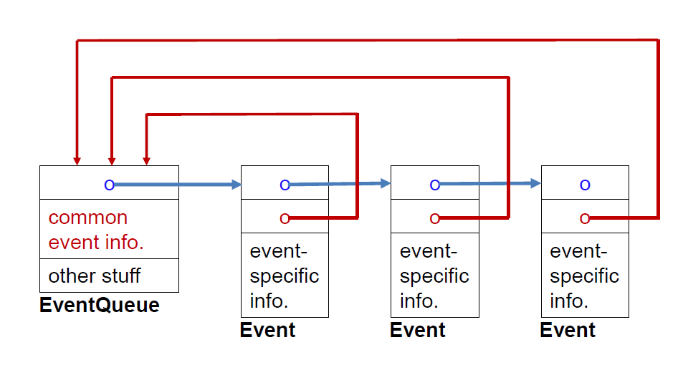
Levelization technique #2 - Demotion
This will look like this during runtime:
Everybody knows everything.
More specifically, Event knows everything about EventQueue.

Slide 51
Levelization technique #2 - Demotion
The solution is to create a new CommonEventInfo class and place it lower in the hierarchy tree.
For example:
// EventQueue.h
#include “Event.h”
#include “CommonEventInfo.h”
class EventQueue {
List<Event> m_events;
CommonEventInfo m_common;
};
//Event.h
#include “CommonEventInfo.h”
class Event {
CommonEventInfo * m_common;
public:
int commonEventInfo() const;
};
3
EventQueue
List
Event
1
2
CommonEventInfo
//CommonEventInfo.h
class CommonEventInfo {
// …
};
1
Uses-in-the-interface
Uses-in-the-implementation
Physical dependency

Slide 52
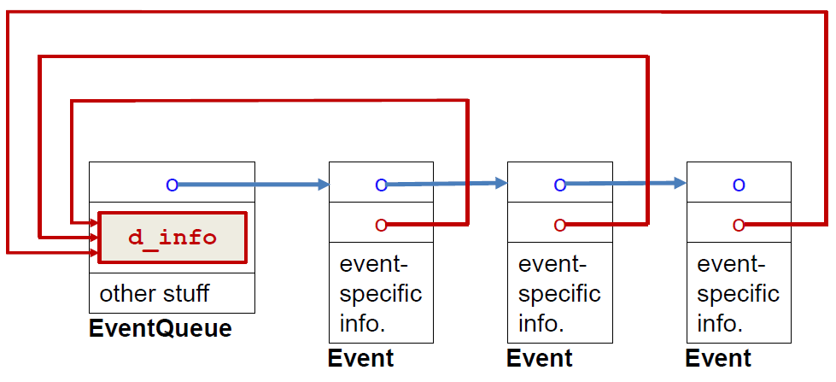
Levelization technique #2 - Demotion
This will look like this during runtime:
Now Event is only aware of the info that it needs inside EvenQueue, and not the whole EventQueue.

Slide 53
Levelization technique #3 – Opaque Pointers
Having an object use another in name only.
For example:
// Manager.h
#include “Employee.h”
#include “List.h”
class Manager {
List<Employee> m_staff;
int numStaff() const;
};
// Employee.h
Class Manager;
class Employee {
Manager* m_boss;
public:
int numStaff() const;
};
Manager
Employee
List
Uses-in-the-interface
Uses-in-the-implementation
Physical dependency
// main.cpp
#include “Employee.h”
int askEmployeeNumStaff(const Employee& employee)
{
return employee.numStaff();
}
// Employee.cpp
#include “Manager.h”
int Employee::numStaff() const {
return m_boss->numStaff();
}

Slide 54
Levelization technique #3 – Opaque Pointers
Now we will replace Employee::numStaff() with Employee::manager(), and adjust askEmployeeNumStaff in the main accordingly.
2
// Manager.h
#include “Employee.h”
#include “List.h”
class Manager {
List<Employee> m_staff;
int numStaff() const;
}
// Employee.h
Class Manager;
class Employee {
Manager* m_boss;
public:
Manager* manager();
};
Manager
Employee
1
List
1
Uses-in-name-only
Uses-in-the-interface
Uses-in-the-implementation
Physical dependency
// main.cpp
#include “Employee.h”
#include “Manager.h”
int askEmployeeNumStaff(const Employee& employee)
{
return employee.manager()->numStaff();
}
// Employee.cpp
//#include “Manager.h” is not needed
Manager* Employee::manager() const {
return m_boss;
}

Slide 55
Levelization technique #4 – Dumb data
Using data that indicates a dependency on a peer object, but only in the context of a separate, higher-level object.
For example:
// Node.h
#include “Edge.h”
class Node {
List<Edge*> m_edges;
};
//Edge.h
#include “Node.h”
class Edge {
Node* m_from;
Node* m_to;
};
Graph
Node
Edge
List
Uses-in-the-interface
Uses-in-the-implementation
Physical dependency
Notes:
Note: there’s a hidden assumption that Node has functions which use Edge, and vice versa.

Slide 56
Levelization technique #4 – Dumb data
Solving this problem with opaque pointers is possible, we could make Node use Edge in name only and vice versa and move all the needed methods to Graph. This will give us the following dependency graph:
// Node.h
class Edge;
class Node {
List<Edge*> m_edges;
};
//Edge.h
class Node;
class Edge {
Node* m_from;
Node* m_to;
};
// Graph.h
#include “Node.h”
#include “Edge.h”
class Node {
List<Node*> m_nodes;
List<Edge*> m_edges;
public:
// Methods that use Edge and / or Node
};
Graph
Node
Edge
List
Uses-in-name-only
Uses-in-the-interface
Uses-in-the-implementation
Physical dependency

Slide 57
Levelization technique #4 – Dumb data
But suppose we need a better solution, where Node doesn’t know about Edge at all and vice versa. A solution that will give us this dependency graph:
Graph
Node
Edge
List
Uses-in-the-interface
Uses-in-the-implementation
Physical dependency

Slide 58
Levelization technique #4 – Dumb data
That can be achieved using dumb data, which in this case would be using IDs / indexes instead of pointers for edges and nodes and handling every operation that requires knowing about Edge and / or Node in the Graph.
// Node.h
class Node {
List<int> m_edges;
};
//Edge.h
class Edge {
int m_from;
int m_to;
};
3
// Graph.h
#include “Node.h”
#include “Edge.h”
class Node {
Map<int, Node*> m_nodes;
Map<int, Edge*> m_edges;
public:
// Methods that use Edge and / or Node
};
Graph
Node
Edge
2
1
List
1
Uses-in-the-interface
Uses-in-the-implementation
Physical dependency

Slide 59
Levelization technique #4 – Dumb data
Now a function that looked like this with opaque pointers:
Will look like this with dumb data:
int Graph::firstEdgeWeight(const Node* node)
{
return node->edge(0)->weight();
}
int Graph::firstEdgeWeight(int nodeId)
{
int edgeId = m_nodes[nodeId]->edge(0);
return m_edges[edgeId]->weight();
}

Slide 60
Levelization technique #4 – Dumb data
The code now is uglier, but it has fewer physical dependencies.
Plus, now each one of Node, Edge and Graph is serializable. While using opaque pointers makes the Graph serializable as a whole unit.

Slide 61
Levelization technique #5 – Redundancy
Deliberately avoiding reuse by repeating a small amount of code or data in 2 different classes / components.
For this example, let’s say we have two big classes that are widely used, and both have an identical small piece of code:
int min(int a, int b)
{
return a > b ? b : a;
}

Slide 62
Levelization technique #5 – Redundancy
Keeping this function in only one class and making the second class depend on the first one is not a good idea, because this will add unnecessary dependencies and will increase compile time since both class are big and used by a lot of other classes.
I think almost everyone will agree that creating a new file just for this method is an overkill.
In conclusion, unless there’s already an existing place where this function can be moved, it’s okay it keep the duplicated code (when it’s simple / short enough).

Slide 63
Levelization technique #6 – Callbacks
Using supplied functions / data that enable lower-level subsystems to perform specific tasks in a more global context.
There are 5 types of callbacks:
Data callback
Function callback
Functor callback
Protocol callback
Concept callback (Will not be discussed here, check out John Lakos’ lectures (part 2) in the references for more info)

Slide 64
Levelization technique #6 – Data Callbacks
Data callbacks are effectively demotion.
We’ll go back to the manager / employee example:
Manager
Employee
// Manager.h
#include “Employee.h”
#include “List.h”
class Manager {
List<Employee> m_staff;
int numStaff() const;
};
// Employee.h
Class Manager;
class Employee {
Manager* m_boss;
public:
int numStaff() const;
}
List
Uses-in-the-interface
Uses-in-the-implementation
Physical dependency
// main.cpp
#include “Employee.h”
int askEmployeeNumStaff(const Employee& employee)
{
return employee.numStaff();
}
// Employee.cpp
#include “Manager.h”
int Employee::numStaff() const {
return m_boss.numStaff();
}

Slide 65
Levelization technique #6 – Data Callbacks
We can add a new data member to Manager (int m_numStaff;) and install a pointer to it in the Employee.
// Manager.h
#include “Employee.h”
class Manager {
List<Employee> m_staff;
int m_numStaff = 0;
};
// Employee.h
class Employee {
int* const m_numStaffPtr;
public:
int numStaff() const;
};
Manager
Employee
List
Uses-in-the-interface
// Employee.cpp
#include “Manager.h”
int Employee::numStaff() const {
return *m_numStaffPtr;
}
Uses-in-the-implementation
Physical dependency

Slide 66
Levelization technique #6 – Data Callbacks
This is very similar to what we did in the Demotion example (Event and EventCommonData)
// Manager.h
#include “Employee.h”
class Manager {
List<Employee> m_staff;
int m_numStaff = 0;
};
// Employee.h
class Employee {
int* const m_numStaffPtr;
public:
int numStaff() const;
};
Manager
Employee
List
Uses-in-the-interface
// Employee.cpp
#include “Manager.h”
int Employee::numStaff() const {
return *m_numStaffPtr;
}
Uses-in-the-implementation
Physical dependency

Slide 67
Levelization technique #6 – Function/Functor Callbacks
In the employee / manager example, we can install a pointer to a function that returns the number of staff in the employee instead of an integer pointer.
// Manager.h
#include “Employee.h”
#include “List.h”
class Manager {
List<Employee> m_staff;
int numStaff() const;
void addEmploye(Employee e)
{
e.setNumStaffCB(&numStaff);
}
};
// Employee.h
Class Manager;
class Employee {
Manager* m_boss;
typedef int (*NumStaffCB)();
NumStaffCB m_numStaffCB;
public:
int numStaff() const;
// …
};
Manager
Employee
List
Uses-in-the-interface
Uses-in-the-implementation
Physical dependency
// Employee.cpp
#include “Manager.h”
int Employee::numStaff() const {
return m_numStaffCB();
}

Slide 68
Levelization technique #6 – Function/Functor Callbacks
Similar behavior can be achieved using functors, so I will not show an example for functor callback, but you can check out John Lakos’ lecture (part 2) which is found in the references at the end of this presentation.

Slide 69
Levelization technique #6 – Protocol Callbacks
Protocol callback techniques include abstract interfaces, listeners, …
A concrete example:
// Blackjack.h
#include “Player.h”
class Blackjack {
addPlayer(const Player* p);
};
// Player.h
#include “Blackjack.h”
class Player {
int bet(Blackjack& g);
}
Blackjack
Player
Uses-in-the-interface
Uses-in-the-implementation
Physical dependency
Notes:
Note: add List<Player> to Blackjack.h to justify including Player.h

Slide 70
Levelization technique #6 – Protocol Callbacks
The solution here is to break the Player class into 2 classes, one abstract class and one concrete class.
// RealPlayer.h
#include “Blackjack.h”
#include “AbsPlayer.h”
class Player : public AbsPlayer {
int bet(Blackjack& game) override;
}
RealPlayer
// Blackjack.h
#include “AbsPlayer.h”
class Blackjack {
addPlayer(const AbsPlayer* p);
};
Blackjack
AbsPlayer
// AbsPlayer.h
Class Blackjack;
class AbsPlayer {
// …
public:
virtual int bet(Blackjack& game) = 0;
// …
}
Uses-in-name-only
Uses-in-the-interface
Uses-in-the-implementation
Physical dependency

Slide 71
Levelization technique #6 – Protocol Callbacks
Another advantage that is introduced by protocol callbacks is extensibility. We can easily add new player types: BotPlayer, NetworkPlayer, …
// RealPlayer.h
#include “Blackjack.h”
#include “AbsPlayer.h”
class Player : public AbsPlayer {
int bet(Blackjack& game) override;
}
RealPlayer
// Blackjack.h
#include “AbsPlayer.h”
class Blackjack {
addPlayer(const AbsPlayer* p);
};
Blackjack
AbsPlayer
// AbsPlayer.h
Class Blackjack;
class AbsPlayer {
// …
public:
virtual int bet(Blackjack& game) = 0;
// …
}
Uses-in-name-only
Uses-in-the-interface
Uses-in-the-implementation
Physical dependency

Slide 72
Levelization technique #7 – Manager Class
Establishing a class that owns and coordinates lower-level object.
This technique is more of an organizational technique than a levelization technique.
Let’s go back to the first suggested solution for the graph example in the “Dumb Data” slides.

Slide 73
Levelization technique #7 – Manager Class
In that example, there’s no real need for exposing the Node and Edge class to the user. Using a manager class in this case means wrapping the whole graph implementation into one component.
GraphManager
Graph
Graph
Node
Edge
Node
Edge
List
List

Slide 74
Levelization technique #8 – Factoring and Escalating Encapsulations
These techniques will not be discussed here, because they’re mostly relevant to library designers.
However, I think it’s interesting and worth checking out.
Check out John Lakos’ lectures (part 2 & 3) for more info.

Slide 75
Insulation

Slide 76
Logical Encapsulation vs. Physical Insulation
An implementation detail of a component (type, data, or function) that can be altered, added, or removed without forcing clients to rework their code is said to be encapsulated.
An implementation detail of a component (type, data, or function) that can be altered, added, or removed without forcing clients to recompile is said to be insulated.
A client can be a programmer (if we’re talking about designing libraries), or another class or file that uses the mentioned component.

Slide 77
Logical Encapsulation vs. Physical Insulation
Let’s say we’re adding a new data member to B
B.h
B.cpp
C.h
C.cpp
As a result, A has to recompile, so does the client. But no code reworking by the client is needed.
So “B” is encapsulated by “A”
#include “B.h”
#include “C.h”
A.h
A.cpp
Client
#include “A.h”
Main.cpp

Slide 78
Logical Encapsulation vs. Physical Insulation
B.h
B.cpp
C.h
C.cpp
As a result, A has to recompile, but not the client.
So “C” is insulated by “A”
Let’s say we’re adding a new data member to C
#include “B.h”
#include “C.h”
A.h
A.cpp
Client
#include “A.h”
Main.cpp

Slide 79
Total insulation technique #1- Protocol class / Pure Abstract Interface
The same example used in the Protocol Callbacks slide can be used.

Slide 80
Total insulation technique #2- PIMPL
PIMPL – Pointer to IMPLementation.
A glorified wrapper class.
// Manager.cpp
#include “Manager.h”
class ManagerImpl {
void foo1() { /* do stuff with data members*/ }
// data mambers
};
Manager::Manager() : m_impl(new ManagerImpl) {}
Manager::foo() { m_imp->foo(); }
// Manager.h
class ManagerImpl;
class Manager {
void foo();
// only 1 data member
ManagerImpl* m_impl;
};

Slide 81
Partial insulation techniques – Example 1
Let’s say we have a DataUtil class that has a static int array:
And at some point, we need to change the _data array. Doing that will require all cpp files that include DataUtil.h to recompile. Plus, the _data array will be duplicated in each one of these files. How can we prevent both these issues?
// DataUtil.h
class DataUtil {
static const int _data[] = { 7, 7, 7 ,7 ,7 ,7 ,7};
static const int _dataLength = sizeof(_data) / sizeof(int);
}

Slide 82
Partial insulation techniques – Example 1
// DataUtil.h
class DataUtil {
static const int* _data_p;
static const int _dataLength;
}
// DataUtil.cpp
static const int _data[] = { 7, 7, 7 ,7 ,7 ,7 ,7};
const int* DataUtil::_data_p = _data;
const int DataUtil ::_dataLength = sizeof(_data) / sizeof(int);
Now we can change _data however we want without the pitfalls of the previous implementation.

Slide 83
Partial insulation techniques – Example 2
If we have a function that needs to be defined in the header (template / inline), we can move some parts of this function to the cpp files.
// FileManager.h
#include “FileUtil.h”
class FileManager {
template <class FileContainer>
void copyAndEncryptFiles(FileContainer files, … )
{
…
FileUtil::encrypt(…);
…
}
};

Slide 84
Partial insulation techniques – Example 2
Now we’ll move the encrypt(…) call to the cpp.
// FileManager.h
class FileManager {
void encrypt();
template <class FileContainer>
void copyAndEncryptFiles(FileContainer files, … )
{
…
encrypt(…);
…
}
};
// FileManager.cpp
#include “FileManager.h”
#include “FileUtil.h”
void FileManager::encrypt()
{
FileUtil::encrypt(…)
}

Slide 85

Partial insulation techniques – Example 2
What did we gain from moving the encryption implementation from the header to the cpp ?
We don’t have to include FileUtil.h in FilesManager.h, so other files that include FilesManager.h will not automatically include FileUtil.h indirectly.
If we decided to change the way we encrypt files, we might be able to do so in the cpp file without affecting the header file, that way all files that include FilesManager.h will not have to recompile.

Slide 86
Miscellaneous ways to speed up compilation

Slide 87
Excessive includes
As we mentioned earlier, The preprocessor will copy each one of the included header files (recursively) into the cpp file and create matching .ii files.
Using superfluous includes can affect compilation in 2 ways:
Slower compilation: resolving headers is a recursive a copy & paste procedure.
Frequent recompilation: If a superfluous header is changed, the cpp file will have to be compiled again, even though it will not make any difference at all.

Slide 88
How bad can it get?
Let’s look at this seemingly innocent code:
// main.cpp
#include <iostream>
int main() {
std::cout << "Hello World!\n";
return 0;
}

Slide 89
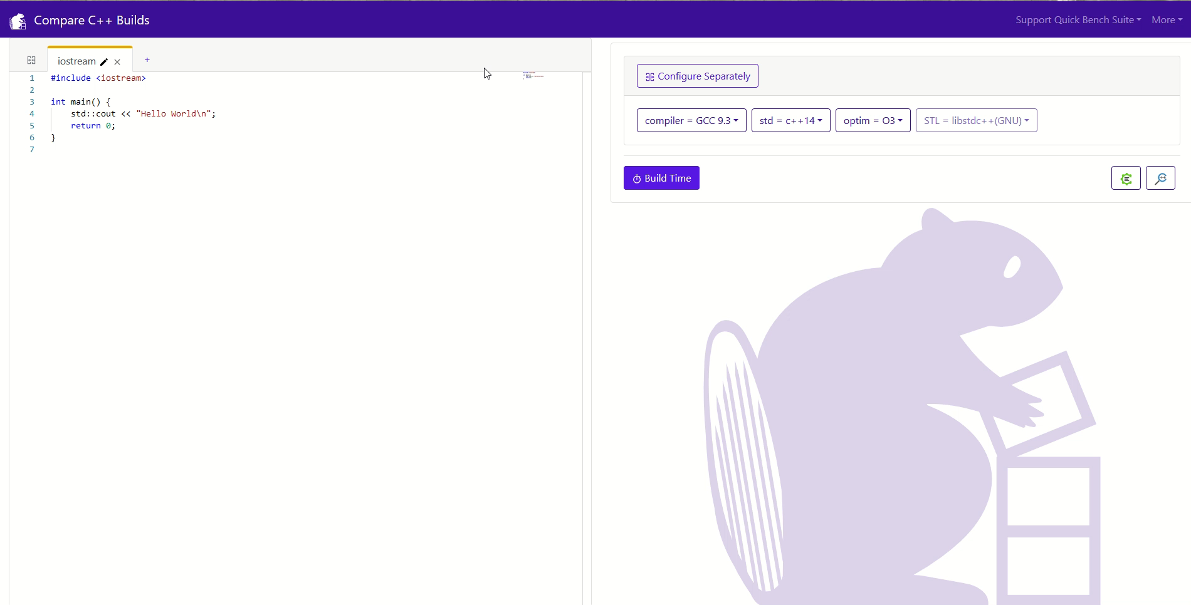
How bad can it get?
According to https://build-bench.com, this is the full list of includes and the full preprocessed file for this example:
// main.cpp
#include <iostream>
int main() {
std::cout << "Hello World\n";
return 0;
}

Slide 90


How bad can it get?
215 includes in total, and a preprocessed file of 28k lines!
Meanwhile, gcc is crying alone in the corner.
// main.cpp
#include <iostream>
int main() {
std::cout << "Hello World\n";
return 0;
}

Slide 91
Getting rid of excessive includes - iwyu
include what you use
The include-what-you-use tool is a program that to analyzes #includes of source files to find include-what-you-use violations and suggest fixes for them.
The main goal of include-what-you-use is to remove superfluous #includes. It does this both by figuring out what #includes are not actually needed for a file (for both .cc and .h files) and replacing #includes with forward declarations when possible.

Slide 92
Getting rid of excessive includes - iwyu
The results of iwyu should be used carefully.
“It (iwyu) was originally written to work specifically in the Google source tree, and may make assumptions, or have gaps, that are immediately and embarrassingly evident in other types of code.”
Taken from https://github.com/include-what-you-use/include-what-you-use/blob/master/README.md
iwyu can detect superfluous includes but can also suggest removing some includes just because they’re included indirectly from another file. And while that will certainly make the file shorter and look cleaner, the preprocessed file’s size will not change, and we mentioned earlier why it might be better to include all the headers we need directly rather than counting on other files to include them.
Notes:
Note: maybe add example instead of the deleted JG example

Slide 93
Getting rid of excessive includes – Forward declaration
Forward declarations can help avoid unnecessary includes.
A forward declaration can replace an include in the following cases:
The class is only used as a pointer or reference only in the file.
The class is used as a function return type.
Be careful about forward declaring classes from external libraries.
And “Be careful” here means never do that.
Because you don't know if there are default template arguments, or if they will be added later.

Slide 94
Getting rid of excessive includes – Forward declaration
Some popular external library classes offer forward declaration headers, which can be included instead of including the whole class. For example:
boost/optional/optional_fwd.hpp
boost/variant/variant_fwd.hpp
<iosfwd>

Slide 95
Getting rid of excessive includes – Using Pointers
When performance is not an issue, we can change a data member to be a pointer to minimize includes in a specific header:
// Foo.h
#include “Helper.h”
class Foo {
Helper m_helper;
}
// Foo.h
Class Helper;
class Foo {
Helper* m_helper;
}

Slide 96
Getting rid of excessive includes – Using Pointers
This will add an additional indirection (using “->” instead of “.” When accessing the helper).
Using smart pointers is preferable to normal pointers.
To use this technique, the D’tor of Foo should be moved to the cpp file, because it will invoke “delete” on this pointer, and therefore it must know the details of the Helper type.

Slide 97
Getting rid of excessive includes – Singletons
Singletons can easily add circular dependencies and excessive includes.
Avoid it like the plague.
There are several other reasons why you should avoid singletons, some of which are not even related to physical design.

Slide 98
Clang
Pronounce Klang.
Clang is a compiler front-end for the C, C++, Objective-C and Objective-C++ programming languages
Some programs might compile in gcc but not in Clang, because Clang will detect some “problems” (some of them can be potential bugs) that gcc will not detect and classifies them as errors, for example iterating over a container with const auto instead of const auto&.
There are several subcomponents to Clang, and several tools that are built on top of Clang. Each one of them specializes in a certain aspect of software development. “iwyu” is one of them, there are others that specialize in syntax checking, auto-formatting, measuring compile time for several components and / or template instantiations, …

Slide 99
Clang
One way Clang could help us achieve faster is by profiling the compilation process and thus showing us the bottlenecks of the compilation (in other words, the problematic files).
For examples and more explanation please visit:
https://raw.githubusercontent.com/vittorioromeo/corecpp2023/main/improving_compilation_times_corecpp2023.pdf

Slide 100
References
John Lakos – Advanced Levelization Techniques
Part 1: https://www.youtube.com/watch?v=QjFpKJ8Xx78
Part 2: https://www.youtube.com/watch?v=fzFOLsFASjU
Part 3: https://www.youtube.com/watch?v=NrARQ7rHV-c
Xavier Bonaventura – Dependency Management in C++
https://www.youtube.com/watch?v=dJpAppmRWVI&
Uncountable StackOverflow pages
https://en.cppreference.com/w/

Slide 101


